Slide 1
Changing the Course of Chronic Disease
One Community At A Time
Nalini Saligram, Ph.D.
Founder & CEO
CHANGING THE COURSE OF
CHRONIC DISEASE… One Community at a Time
OUR SYSTEMS CHANGE JOURNEY 2020 ASHOKA GLOBALIZER
Arogya in Sanskrit means good health. More literally to live a life without disease.
Chronic non-communicable diseases called NCDs, include heart diseases, cancer, diabetes and chronic lung diseases

Slide 2
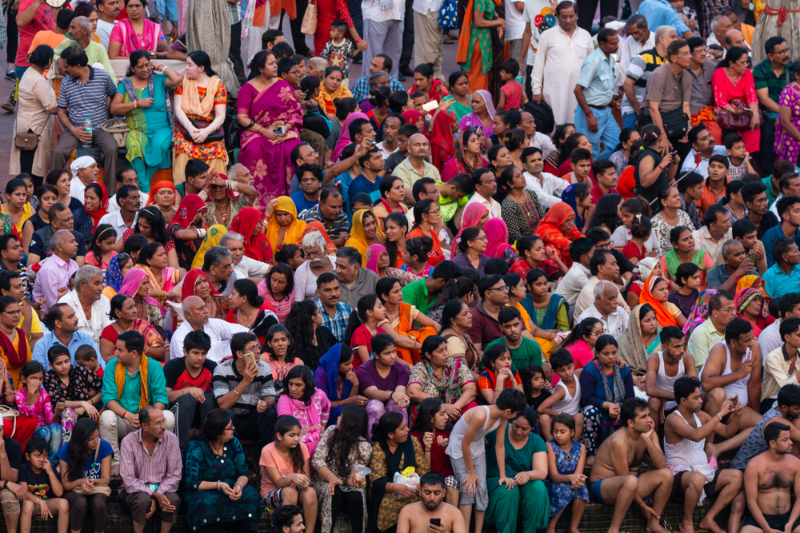
UNHEALTHY EATING IS #1 CAUSE OF DEATHS GLOBALLY
NCD*s Big Problem For
1 billion In India
80%
63%
75%
30s
$47 trillion
Deaths In developing countries
die from NCDs
of adults are diabetic or pre-diabetic
Age at onset
global economic output loss by 2030
*NCDs = Noncommunicable diseases = heart disease, diabetes, cancer, lung diseases + mental health

Slide 3
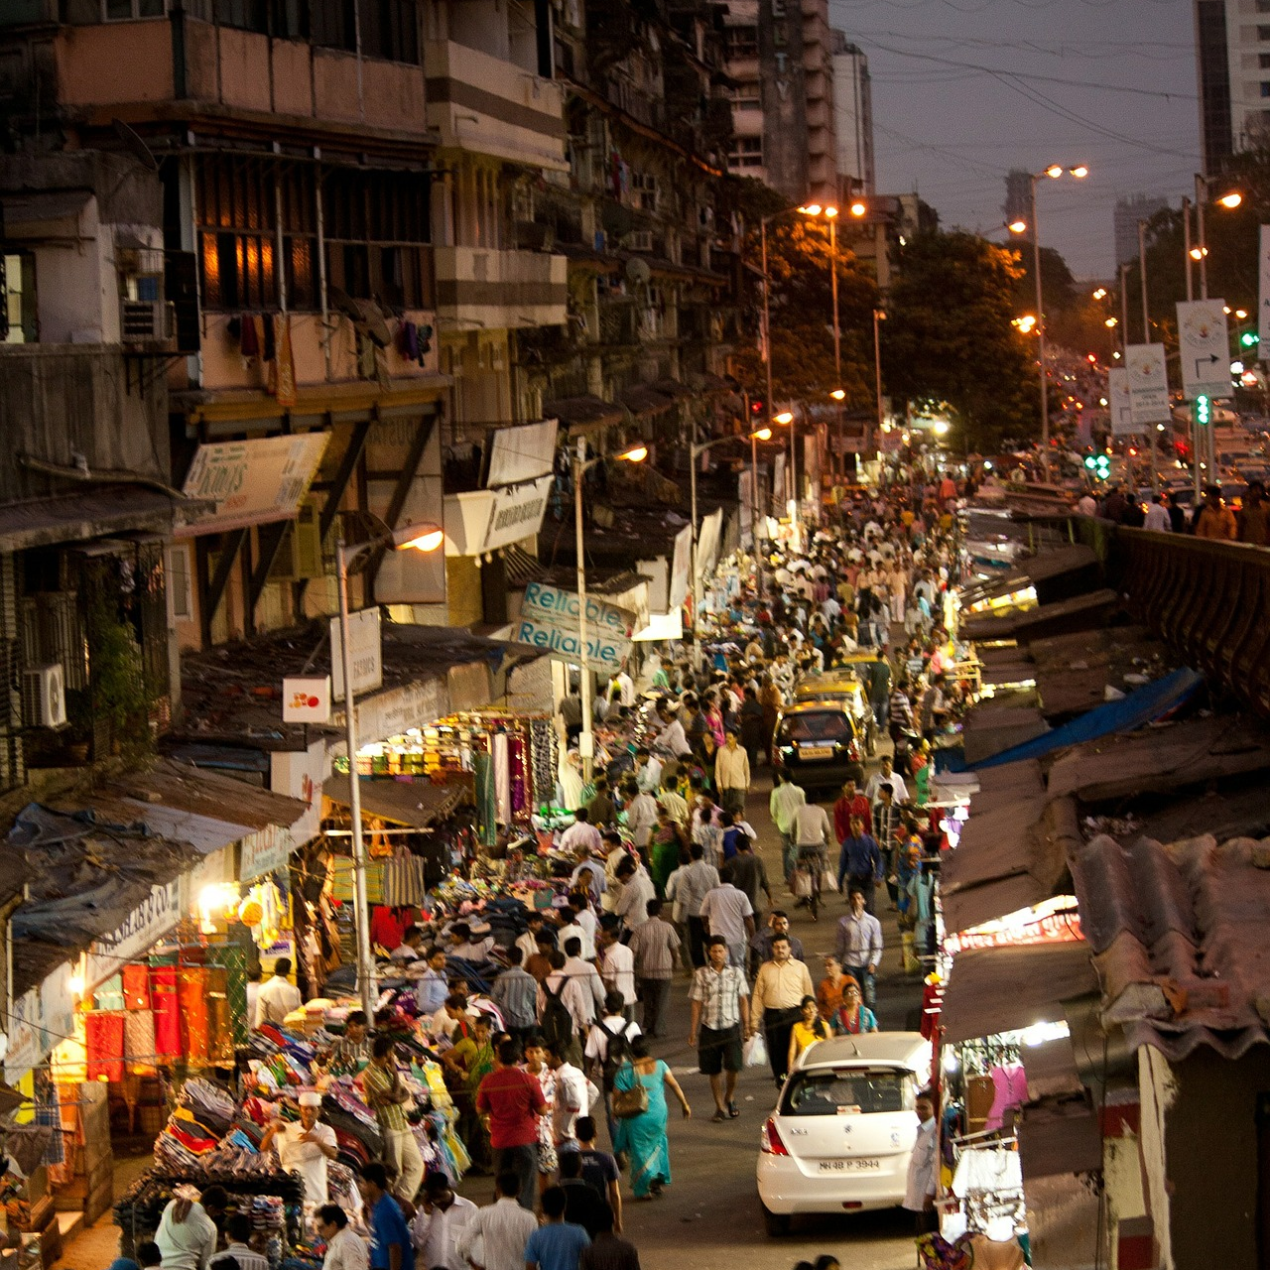
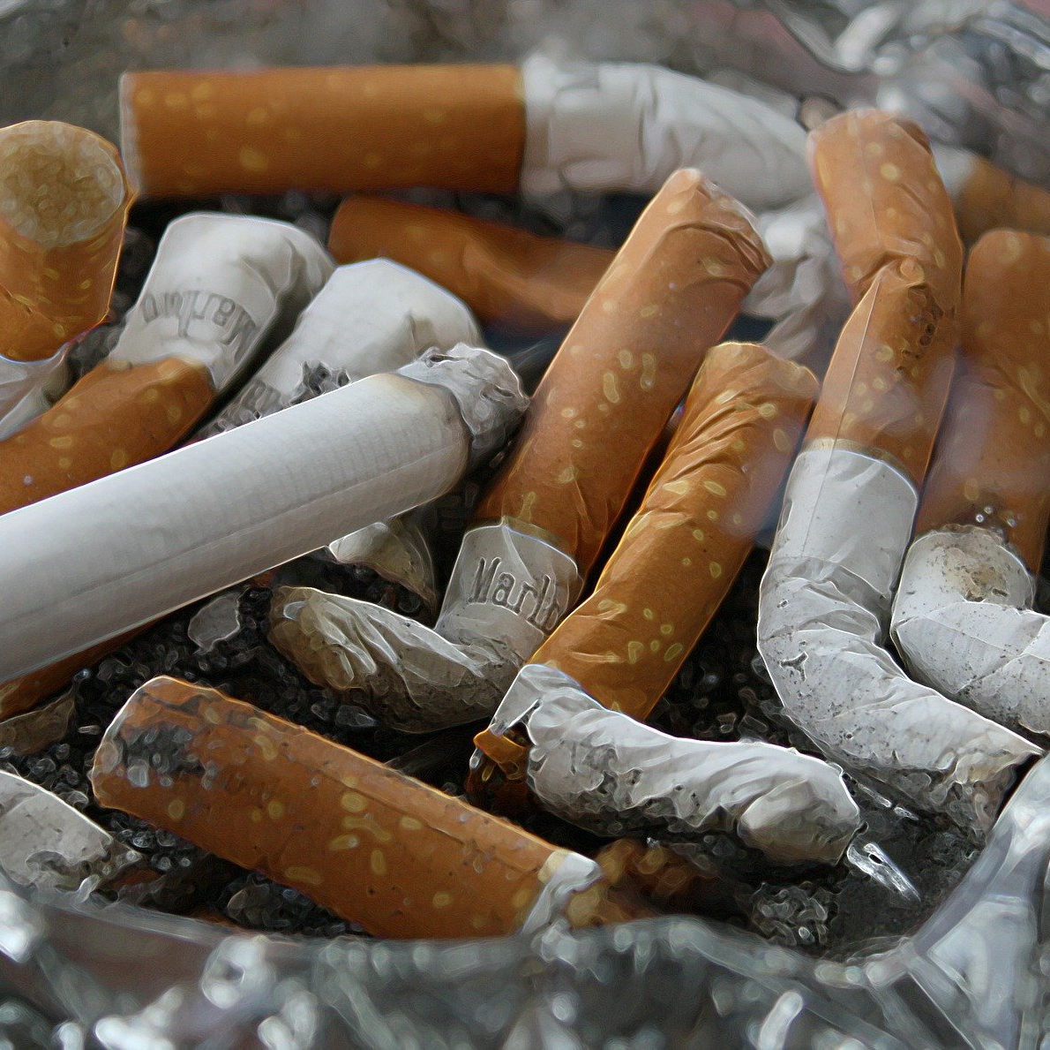
Urbanization
Modern Lifestyle
Big Tobacco and Big Food
Systems That Drive the Big Problem
Health Systems
Employers

Slide 4
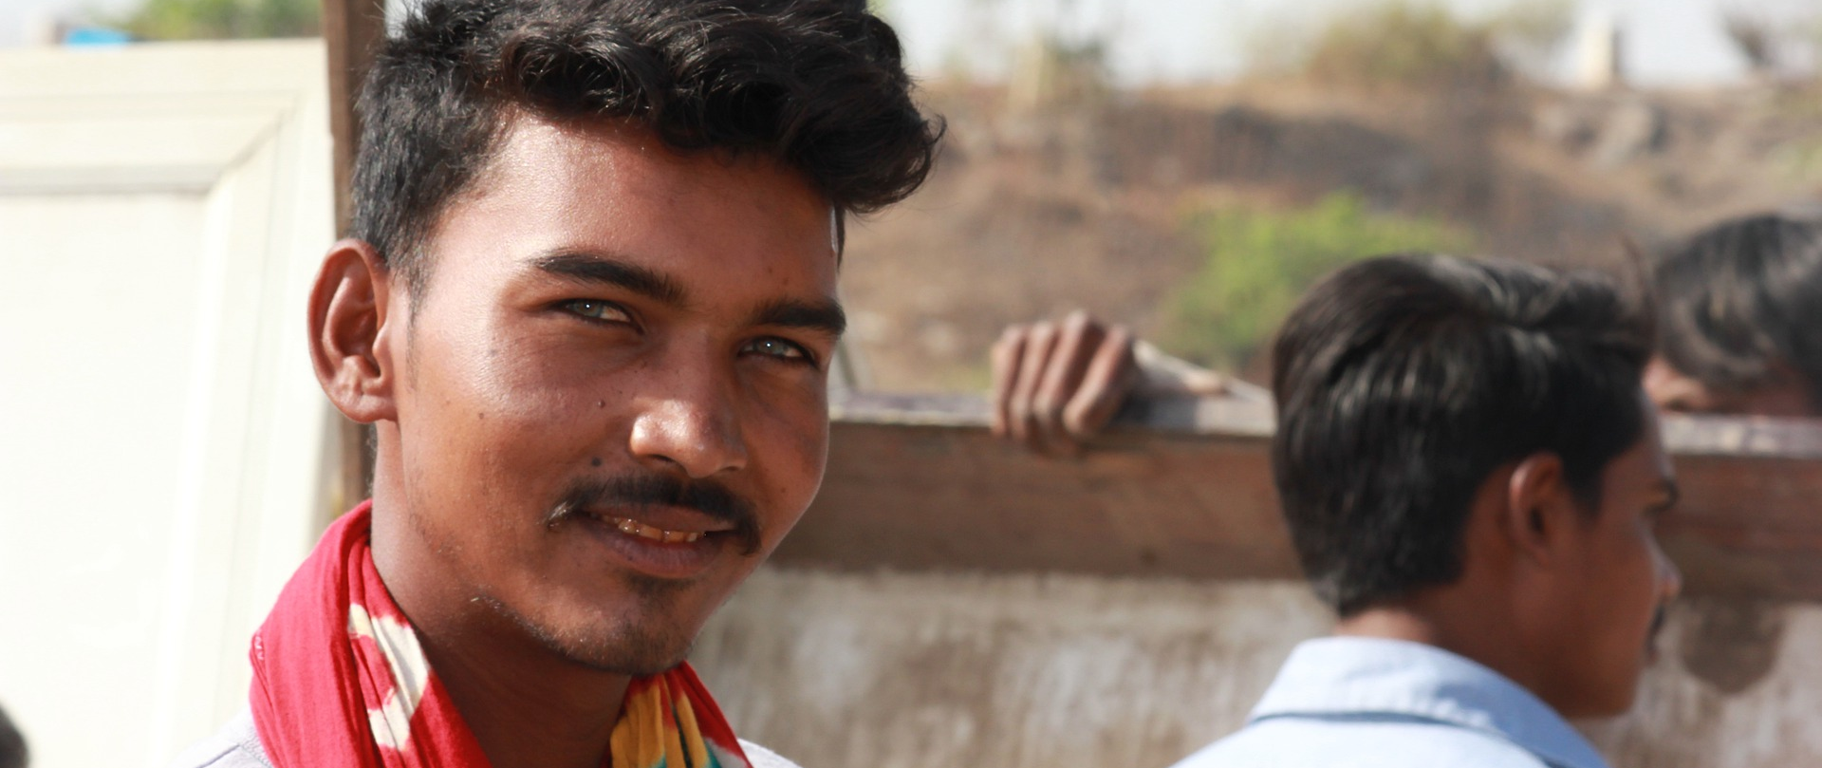
The Solution: Prevention!
According to WHO:
80%
80%
40%
+
+
Can
Prevent
Premature Heart Disease
Type II
Diabetes
Cancers
A Healthy Diet
Exercise
Avoiding Tobacco

Slide 5
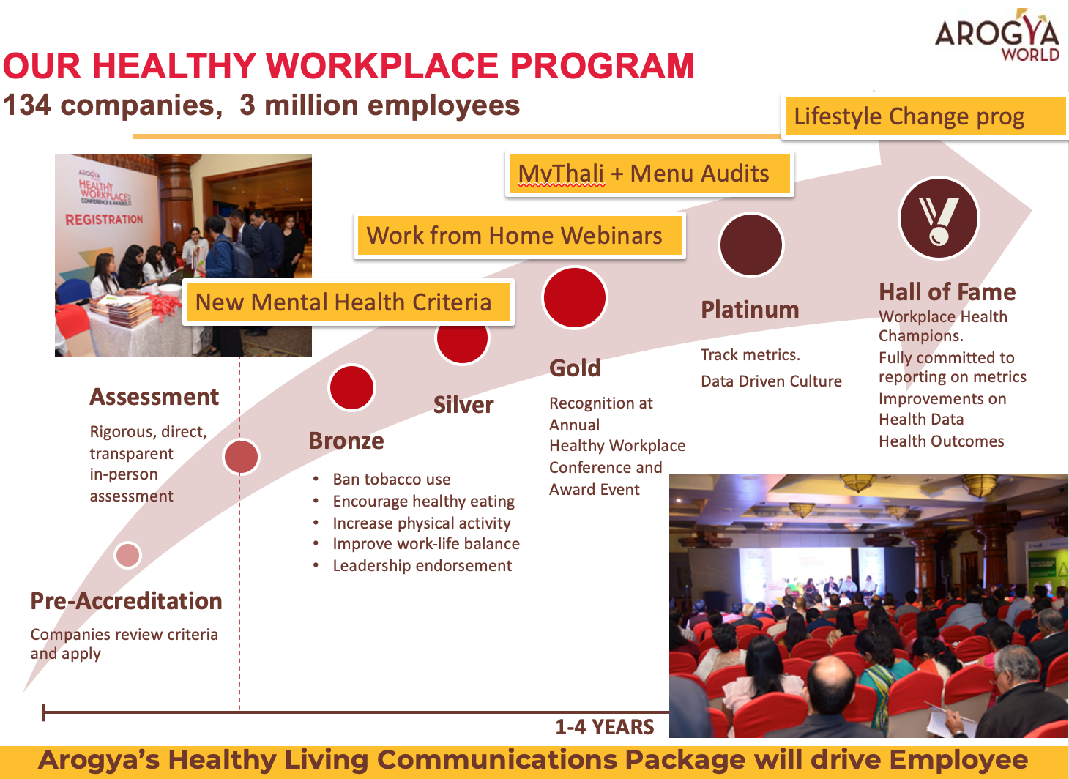
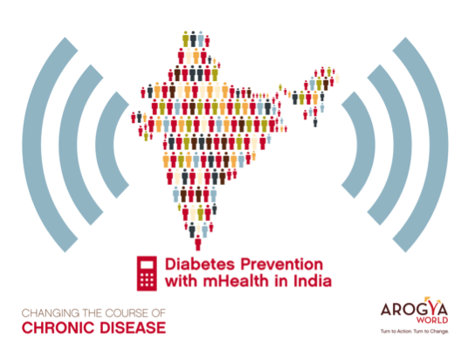
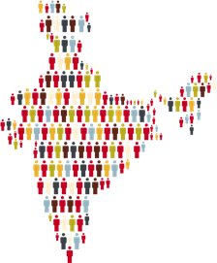
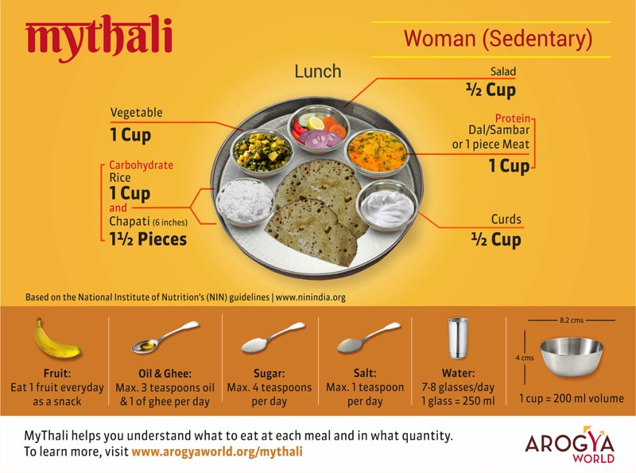
OUR DOORSTEP HEALTH MODEL
We Make Prevention Accessible…..
5 Million+
PEOPLE REACHED
myArogya- Mobile App
Healthy Workplace
> 145 companies,
3.1 million employees
mDiabetes
Reach 1.7 million 20% impact
Live
Work
Learn
Rural
Healthy Schools
MyThali
Urban
Reach 300,000 kids 15% impact
+ Thane Maharashtra,
+ Banda UP
+ Digitizing + Diksha
50 worksites
Social Media 750,000
Media Reach 10 million

Slide 6
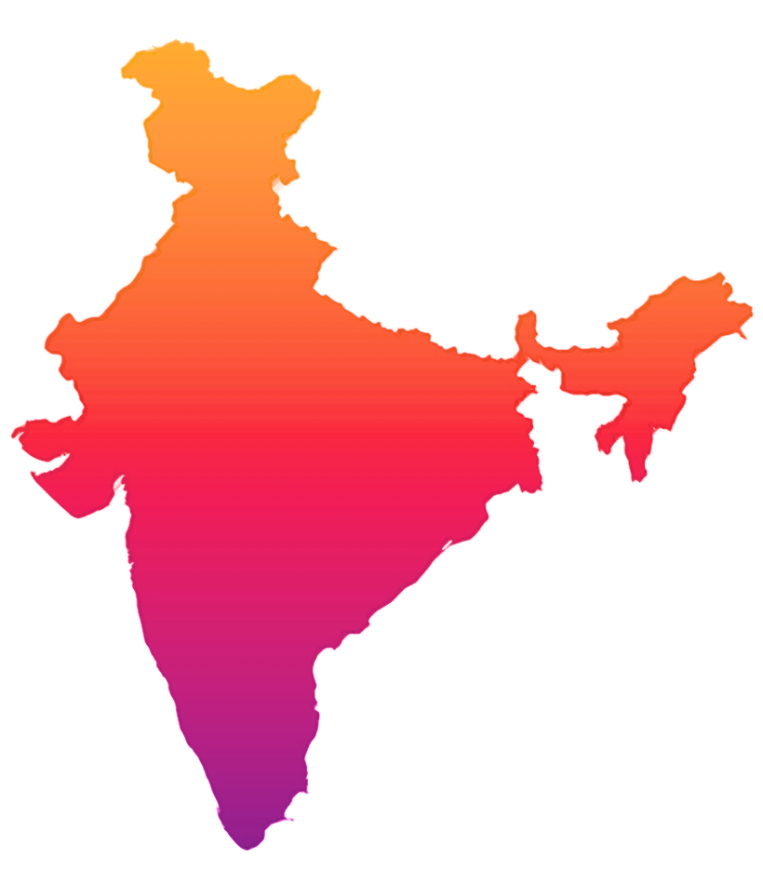
We Work All Over India
Arogya’s reach in India is extensive, and covers over 12 different Indian States and Union Territories.
mDiabetes
Gujarat
Karnataka
Himachal Pradesh
Madhya Pradesh
Maharashtra
Rajasthan
Tamil Nadu
West Bengal
Healthy Schools
Andhra Pradesh
Assam
Bihar
Haryana
Karnataka
Madhya Pradesh
Maharashtra
Rajasthan
Tamil Nadu
Telangana
Uttar Pradesh
West Bengal
Healthy Workplaces
Andhra Pradesh
Assam
Gujarat
Karnataka
Maharashtra
New Delhi
Uttar Pradesh
West Bengal

Slide 7
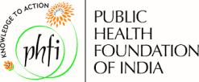
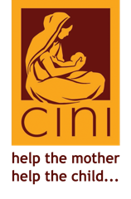
We Have Built Strong Partnerships
Individual Donors
Jamnalal Bajaj Foundation

Slide 8
India’s Billion plus people lead healthier lives and thereby contribute to the best of their potential to society.
The vast country is less burdened by NCDs and meets SDG #3 indicators.
OUR BIG VISION

Slide 9
Our Programs are Thoughtfully Designed

Slide 10
Compelling School Health Program= 15% Impact
PROOF OF CONCEPT
2 year peer-led/self-learning participatory design; aligned with Ayushman Bharat National School Health Curriculum; currently deployed in 300,000 + middle school children; 9 languages, multiple states, rural + urban. Digitized in 4 languages.

Slide 11
PROOF OF CONCEPT
= 20% IMPACT*
A groundbreaking one-million-person diabetes awareness and prevention SMS program in India. A Completed 2011 Clinton Global Initiative Commitment.
Our Partners
Behavior Change Task Force
Text Messages in 12 languages sent to 1 million from all over India who opted in,
twice a week for 6 months. * http://www.jmir.org/2016/8/e207/

Slide 12
MyThali – Empowering Women to Eat Right

Slide 13
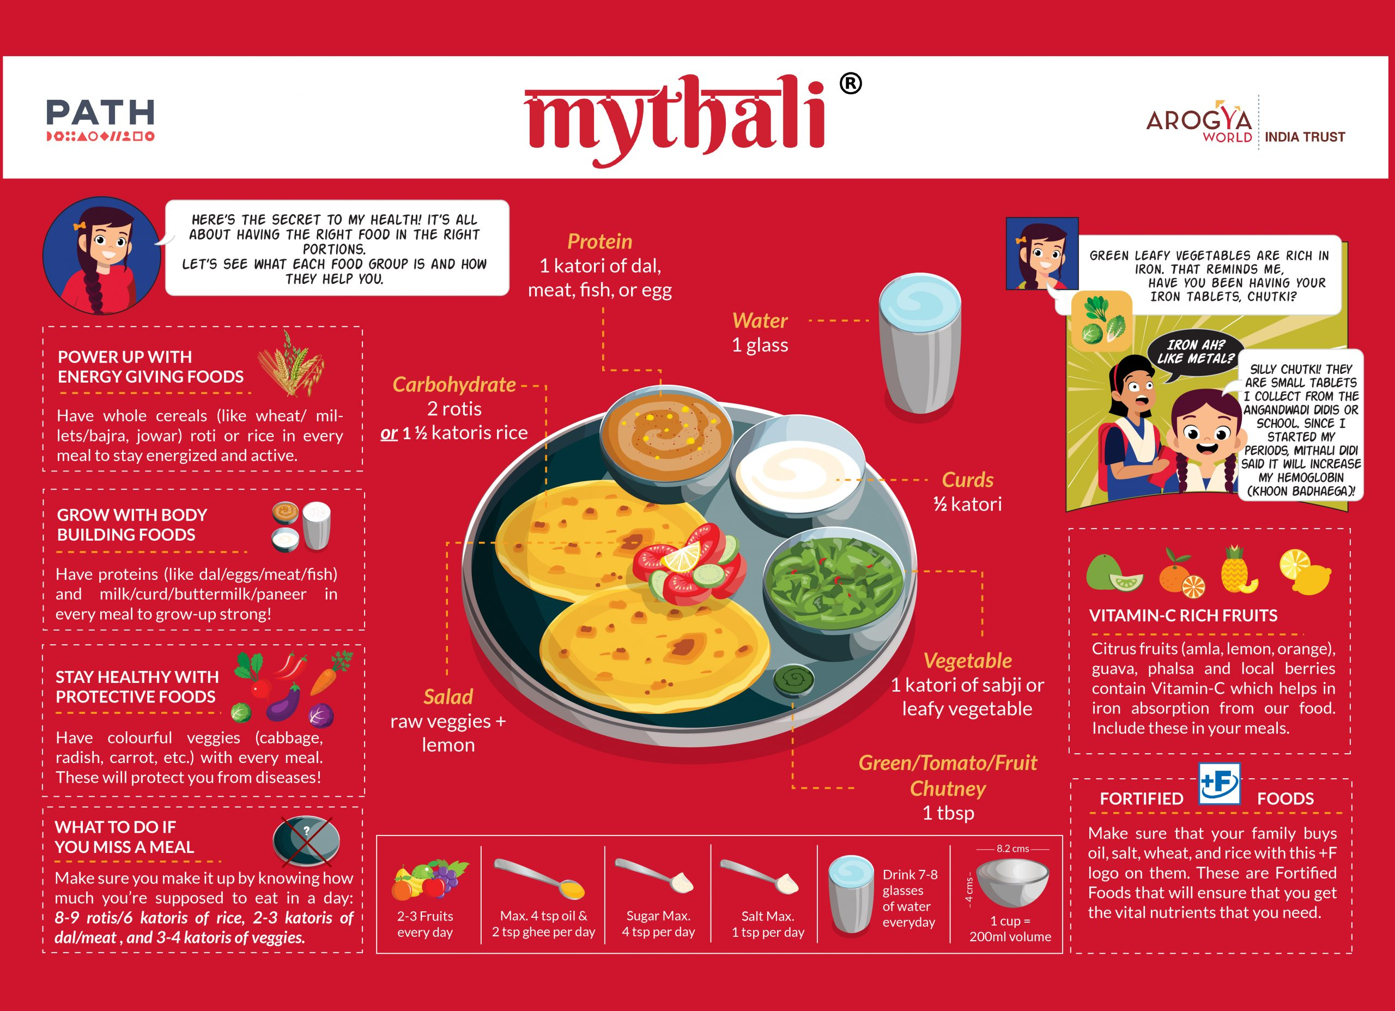
MyThali
EMPOWERING ADOLESCENT GIRLS IN RURAL INDIA TO EAT RIGHT
LIVE
WORK
Align with Poshan. Run advisory committees. Reach girls in school, outside school & evaluate effectiveness.

Slide 14
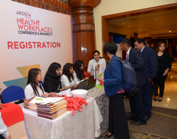
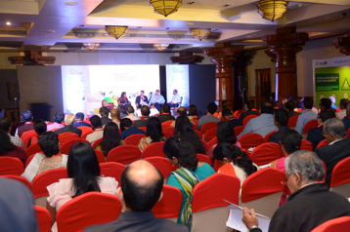
Our Healthy Workplace Program
145 companies, 3.1 million employees
+ Mental Health Criteria
Lifestyle Change Training
MyThali /Menu Audits
Hall of Fame
Workplace Health Champions.
Fully committed to reporting on metrics
Improvements on Health Data
Health Outcomes
Platinum
Track metrics.
Data Driven Culture
Gold
Recognition at Annual
Healthy Workplace Conference and Award Event
Assessment
Rigorous, direct, transparent
in-person assessment
Silver
Bronze
Ban tobacco use
Encourage healthy eating
Increase physical activity
Improve work-life balance
Leadership endorsement
Pre-Accreditation
Companies review criteria and apply
1-4 YEARS
Criteria Co-Created with Industry in 2012;
Mental Health Criteria Added in 2020 with Librum (Harvard profs)

Slide 15
Our Systems Change Journey

Slide 16
Preventive Health System In Indiar
SHARPENING OUR FOCUS TO MAKE CHANGE
The Preventive Health System in India
Current
Future
Many ecosystem players. Complex Dynamics.
Simplified Strategic Focus
Big Food Tobacco
Civil Society
Focus on Sick Care
Agri & Dairy Industry
Strong Lobby
Ayushman Bharat
Healthcare Providers
Consumer Movement on Healthy Living
Civil Society Influences Govt to support NCD prevention
Restrictions
Govt
Consumer
Consumer
Gov’t
Not leveraged enough
More Awareness
Labor laws
consumer-friendly regulations
Tech Players
Civil Society
Insurance Players
Employers
Media
Many ecosystem players. Complex Dynamics.
Simplified Strategic Focus Areas.

Slide 17
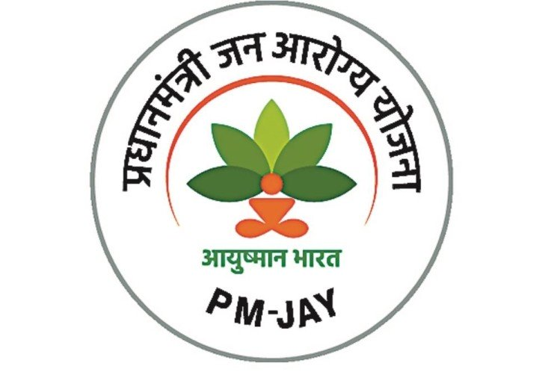
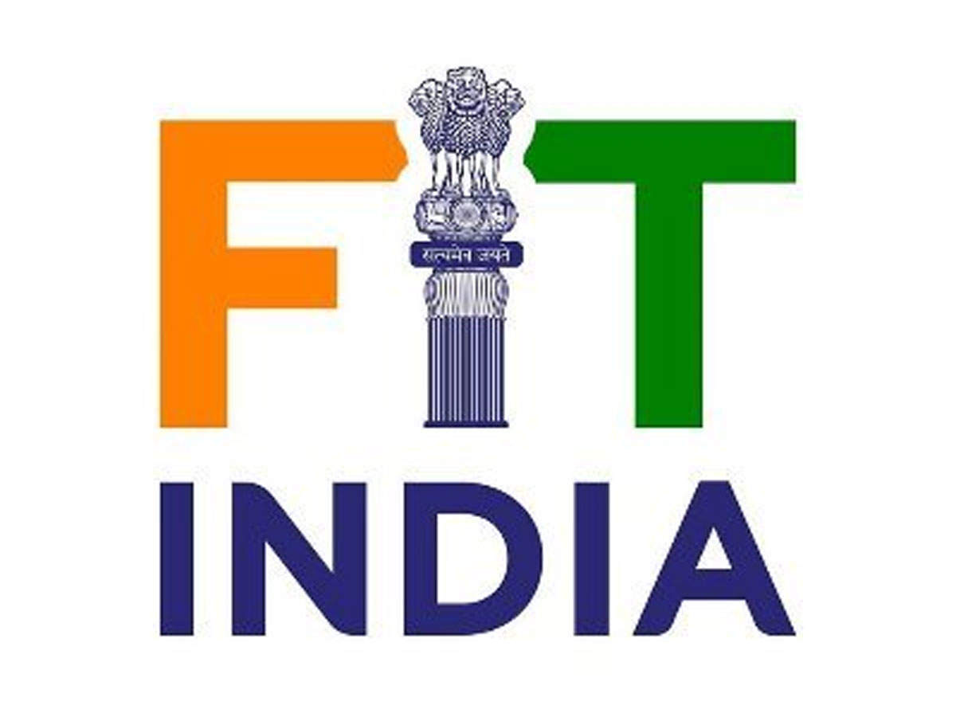
System Change 1
We are working hard to influence the government (central, state and city) to increase its emphasis on NCD prevention in all its programs.

Slide 18
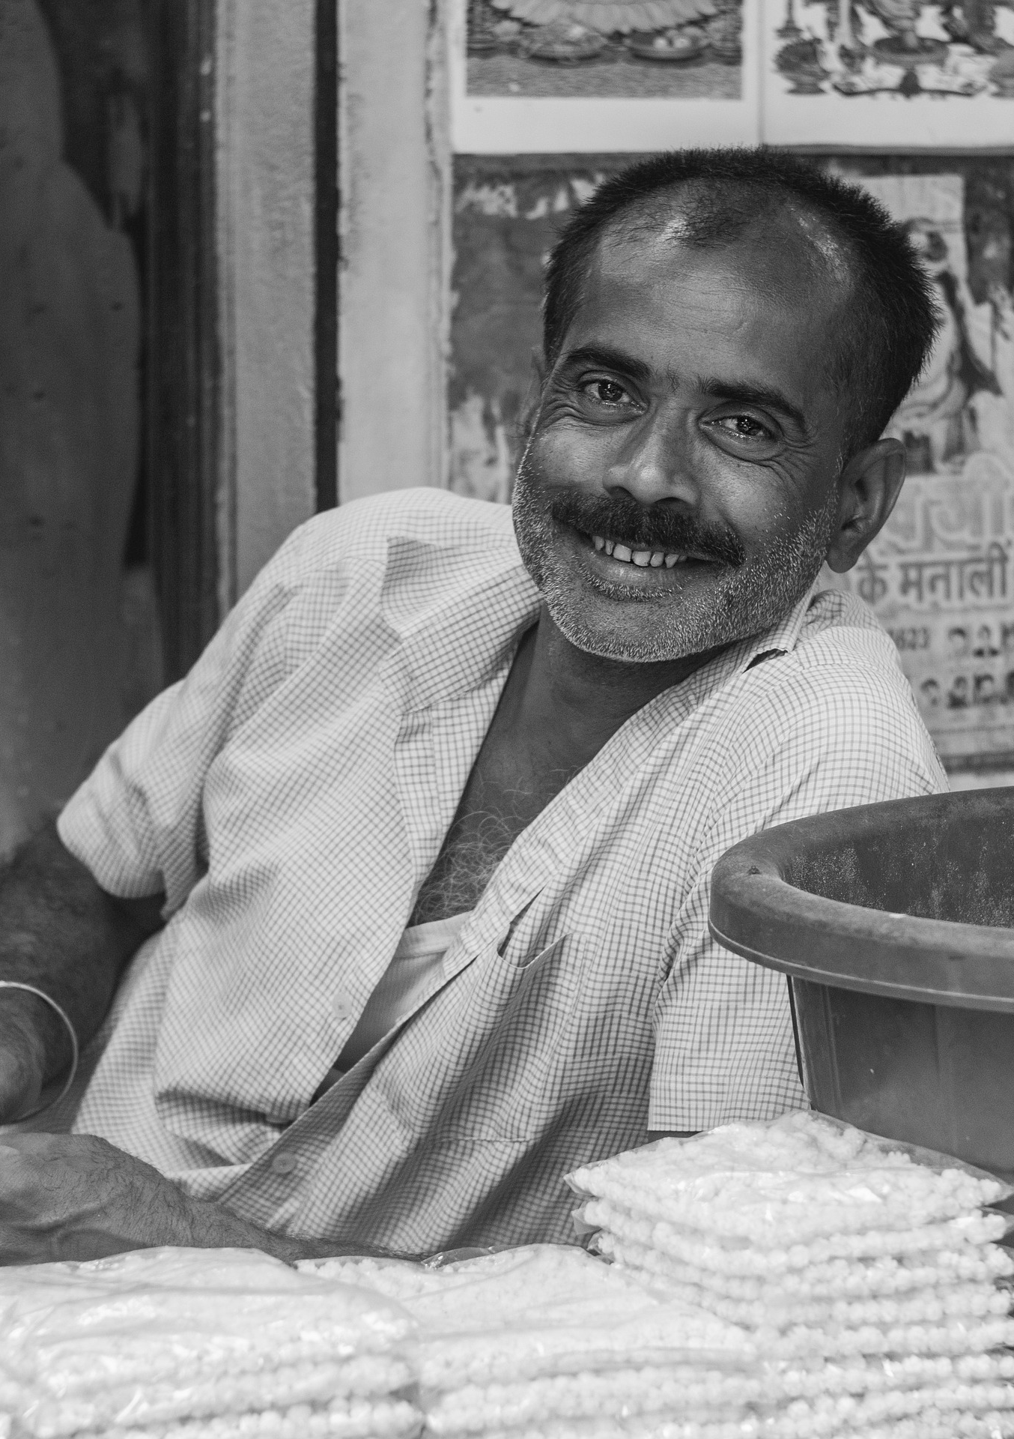
System Change 2
We are Building a Healthy Lifestyle Movement ……
By getting Consumers to take responsibility for their own health and Society to change its mindset and reject unhealthy options and demand healthy lifestyles.
We will leverage influencers, social media and technology to scale

Slide 19
An Overview of Our Govt Work
Central Government
State Government
City Government
NCD Prevention ROI White paper.
With Ashoka, AlphaSights
NCD prevention in schools in UP, Maharashtra by 2022
Build framework for Arogya city with Stanford CARE.
NCD prevention in Ayushman Bharat’s National School Health Program.
Health Help Lines (104) - NCD Prevention. With Piramal Swasthya
1 Arogya city – Bangalore - to hold NCD prevention multi-sectoral summit, with sister city San Francisco, in 2022
Ayushman’s Tech backbone promotes NCD prevention mHealth.
Highest NCD burden states implement NCD prevention
Integrate Arogya city concept in India’s Smart City Initiative
Poshan Abhiyan promotes NCD prevention. With PATH.
Workplace Health Summit to mark India@75. With CII, WHO
Work started, Already Progressing
No work done yet
Work not started, but path forward known

Slide 20
Building a Movement Around Healthy Living
Expand Multi-pronged Community Approach
Leverage Media and Influencers
Scale with Tech
Use doorstep health model to educate 5+ million / yr with NCD prevention programs
Increase strategic communications outputs
Leverage Tech, digitize to scale ie expand reach, increase efficiency, lower cost. Build Arogya Wellness Platform to streamline operations/data. Use AI to increase engagement and improve impact. Use Govt platforms like Diksha
Social Media Influencers + media articles on NCD Prevention/eating right 20/yr
Leverage reach of large partners like Rotary, Piramal Swasthya
Adapt for post-COVID – mental health @work, Digitize schools program
Work with celebrities in creative ways – Chefs (like VahChef), CEOs, cricket/sports star (Mithali Raj) to promote healthy living
Get non-Health NGOs eg Education NGOs and industry bodies like CII on board
Ambassador eg Chef Saby to promote eating right. Inspire student chefs.
Work with Bangalore Foodies Club and other groups of food enthusiasts.
Engage with Swiggy highlight healthy restaurants
Expand Rural MyThali to adolescent girls in school + outside school in the village with PATH; measure effectiveness with Nielsen
Publish Schools Healthy Recipe e-Books
Make rural communities healthy communities
Use Project ECHO to build community
Add NCD Prevention to Disaster Preparedness.
Expand to slums + migrant workers.
Work started, Already Progressing
No work done yet
Work not started, all requirements ready
Leverage Media and Influencers
Social media/influencers + media articles on NCD Prevention/eating right 20/yr
Work with celebrities in creative ways – Chefs, CEOs, cricket/sports star to promote healthy living
Celebrity Ambassador eg Chef Saby to promote eating right. Inspire student chefs.
Work started,
Already progressing
Scale with Tech
Work not started,
All requirements ready
Leverage Tech, digitize all programs to scale ie expand reach, increase efficiency, lower cost. Build Arogya Wellness Platform to streamline operations/data. Use WhatsApp.
No work done on this
Engage with Swiggy/Zomato to highlight healthy restaurants

Slide 21
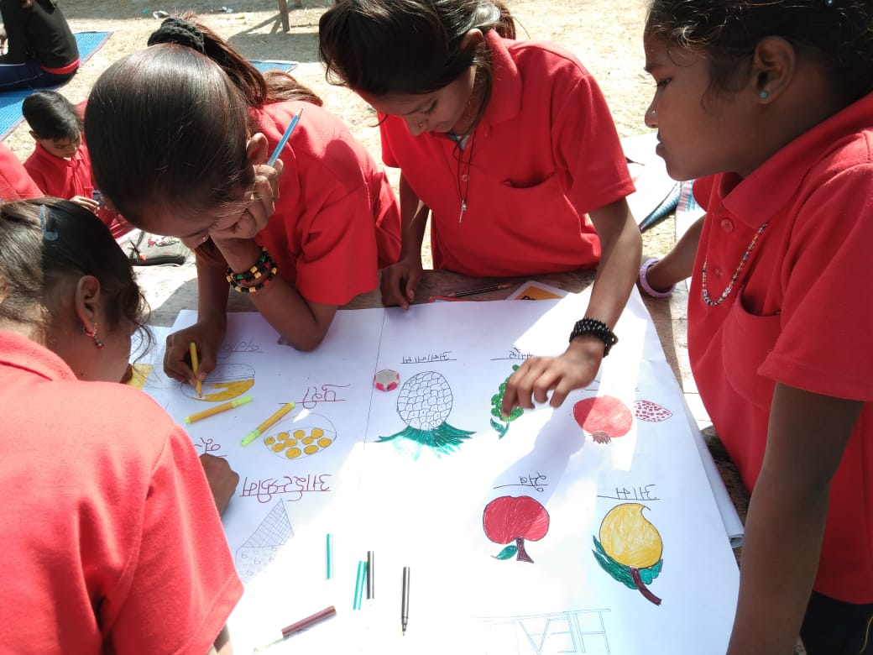
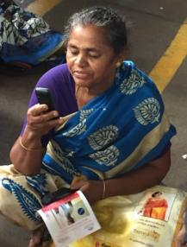
Where Are We Going?
By The End Of 2022 - When India Will Be 75, We Want To Educate 22 Million
2018 | 2020 | 2022
4 million | 10 million | 22 million
 | Implementation Cost | Reach | Cost / Beneficiary
2010-2020 | $3 million | 5 million | 60 cents
2020-2022 | $2 million | 16 million | 12.5 cents

Slide 22
THE AROGYA WORLD FAMILY
Arogya World Family
Arogya World US Board
Dr Nalini Saligram, Founder & CEO • Pamela Yih, CFO • Dr. Seema Bhatia • Deepa Prahalad • Kathryn Graves • Gloria Barone • Denise Freier • Emilie Ninan • Radhika Papandreou • Swati Choudhary • Heather Nornes • Neeru Arora
Arogya World India Trust Board
Dr. Susheela Venkataraman – Chairperson • Ujwal Thakkar • Keshav Desiraju • Dr Ashwin Naik • Dr. Nalini Saligram - Founder Trustee
Consultants/Staff
Meeta Walavalkar, Program Chief • Usha Chander, Head, Healthy Workplace • Dr Smriti Pahwa, Regional Director, North • Ashwini Thakker, Regional Director, West • Shyamala Sami - Finance • Dr. Sandhya Ramalingam, Program Evaluation • Nandan Bhatia, Director, Healthy Workplaces • Dr. Geeta Bharadwaj, Healthy Workplace •. Nandini Ganesh - Healthy Schools • Dr Meghana Pasi, Nutritionist, MyThali • Kshema Kurup, Communications, MyThali • Gene Levin, Finance • Michelle Press, Communications • Vijayalakshmi Hareesh, Healthy Workplace • Raghu S, Tech Lead • Mugdha Gangopadhyay, Chief Development • Dr. Amita Kshirsagar, Schools • Kriti Pradhan, Communications
Experts & Advisors
Dr. K. Srinath Reddy –Public Health Foundation of India (PHFI) • Dr. V. Mohan –Madras Diabetes Research Foundation, (MDRF) • Dr. D. Prabhakaran –PHFI • Dr. Nikhil Tandon –All India Institute of Medical Sciences • Dr. K.M. Venkat Narayan – Emory University • Dr. Bonnie Spring –Northwestern University • Dr.Monika Arora • Dr. Francine Kaufman • Dr. Om P. Ganda • Dr Sethu Reddy • C Mahalingam • Dr Ashish Jain • Dr Balaji Santanam • Prof Maheshwari • Amber Alam • Dr Ruchika Sachdeva (Chair MyThali Advisors)
Arogya World is a US based 501 ( c) 3 non profit. Arogya World India Trust is 80G cleared in India.

Slide 23
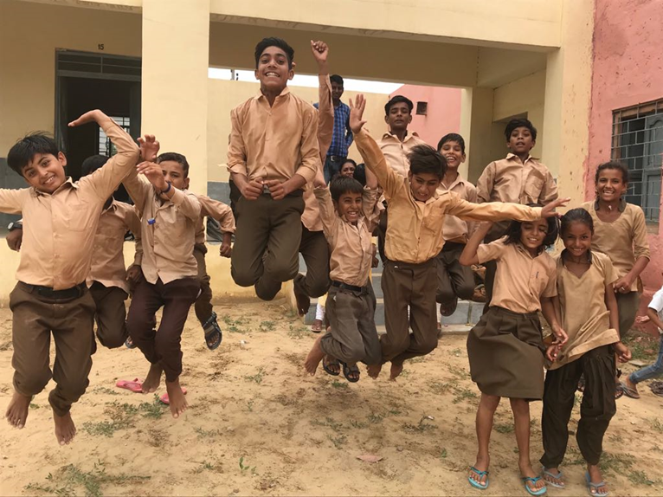
Thank You!

