Slide 1


CHANGING THE COURSE OF CHRONIC DISEASE One Community at a Time
With MyThali - https://arogyaworld.org/mythali/
Arogya in Sanskrit means good health. More literally to live a life without disease.
Chronic non-communicable diseases called NCDs, include heart diseases, cancer, diabetes
and chronic lung diseases

Slide 2

Why MyThali?
Unhealthy Eating is #1 cause of death globally
Global Burden of Disease Report – April 2019
This is the Decade of Action on Nutrition
2016-2025
Eating Right is Key Pillar of NCD Prevention
Transformation to healthy diets by 2050 will require substantial dietary shifts, including a greater than 50% reduction in global consumption of unhealthy foods, such as red meat and sugar, and a greater than 100% increase in consumption of healthy foods, such as nuts, fruits, vegetables, and legumes. – EAT Lancet Commission 2019
By educating women with MyThali about what they and their families should eat and in what quantities at each meal, we can help Indians prevent NCDs and address malnutrition

Slide 3
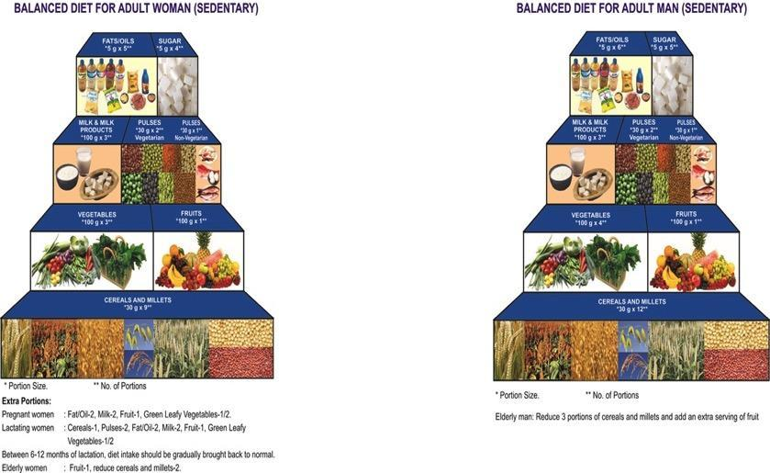
NATIONAL INSTITITUE OF NUTRITION (INDIA) GUIDELINES TOUGH TO FOLLOW

Slide 4
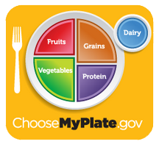
LEARNINGS FROM MY PLATE
MyPlate (US Department of Agriculture), evolved from Food Pyramid and MyPyramid
Designed in 2010 to get people to think about the food they eat.
Easy to understand, consumer friendly
Built around food groups with information on the proportions. This works for all people of all ages - whether they are men or women or children or sedentary or active.
Next steps – cover quantities, ethnic differences

Slide 5
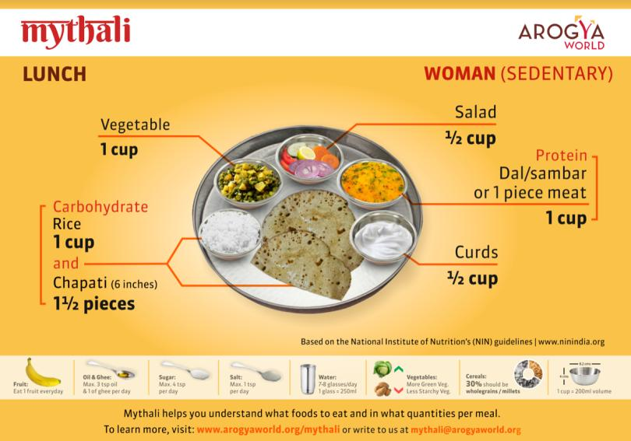
Urban MyThali
EMPOWERING WOMEN TO EAT RIGHT

Slide 6
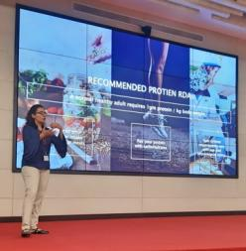

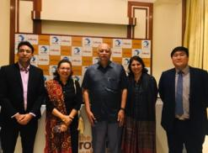
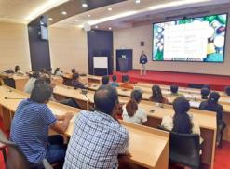
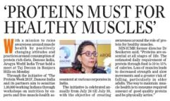
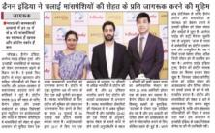
MyThali in Healthy Workplaces
CREATING A HEALTHIER LIFESTYLE WITH A BALANCED DIET
HOW WE DO IT?
Arogya World team develops a custom plan for each Healthy Workplace
Our Nutritionist visits the workplace for a talk on MyThali and to observe the portions sizes served in the cafeteria.
A large tech company rolled out MyThali to its 150,000 employees in Dec 2019.
Based on the observation and the cafeteria menu plan shared by workplace, our nutritionist suggests ways to improve healthy eating options
We send emails with eating right tips to interested employees and also promote MyThali with chef demos, posters, danglers, flyers.
We are talking to Nielsen on impact measurement perhaps via a simple questionnaire to employees and to Canteen supervisor.
We will share results with the workplace
WHAT WILL THE WORKPLACE GET?
Engaging employees on eating right
Nutrition assessment of the current cafeteria menu
Revisions to menu (if needed)
Impact assessment of MyThali education (knowledge and practice assessment)

Slide 7
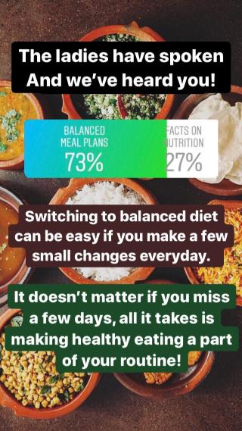

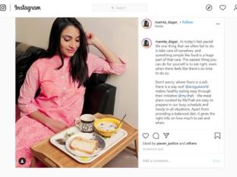


Urban MyThali:
OUTREACH THROUGH SOCIAL MEDIA – since Jan 2020
The MyThali Instagram page engages with urban women through campaigns and influencers, and educates them on the key aspects of nutrition, healthy living tips, poshan (nutrition) and portion.

Slide 8
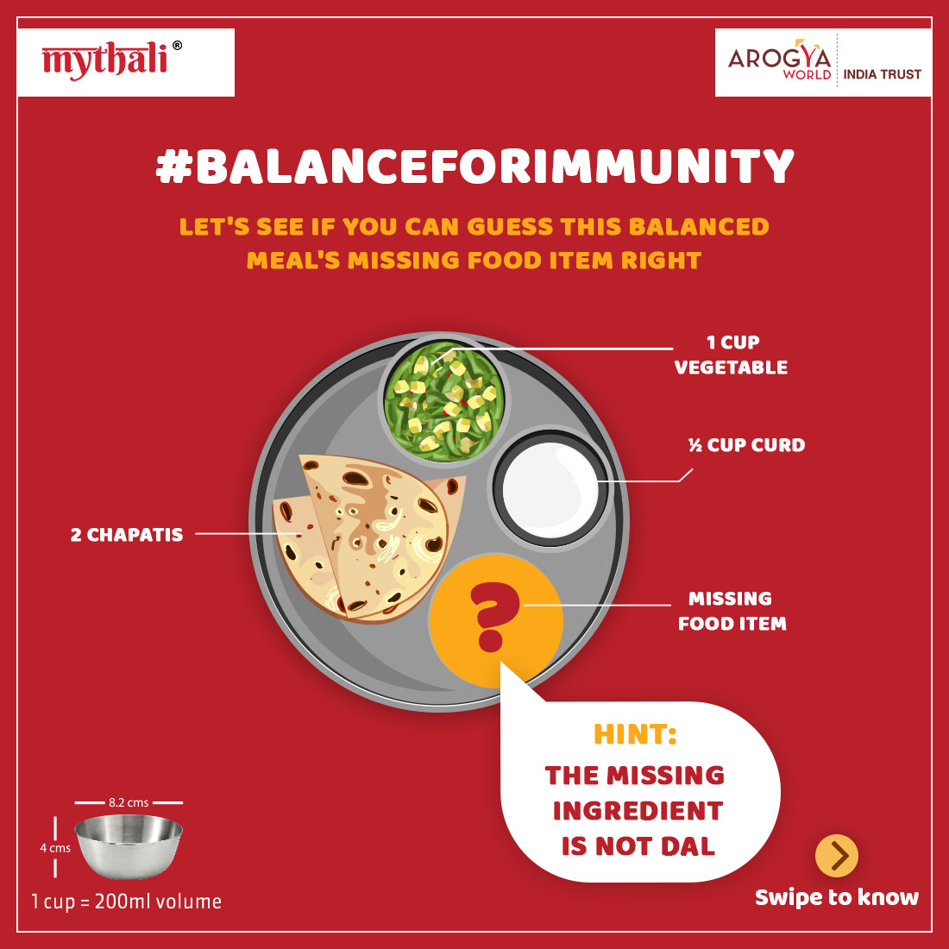
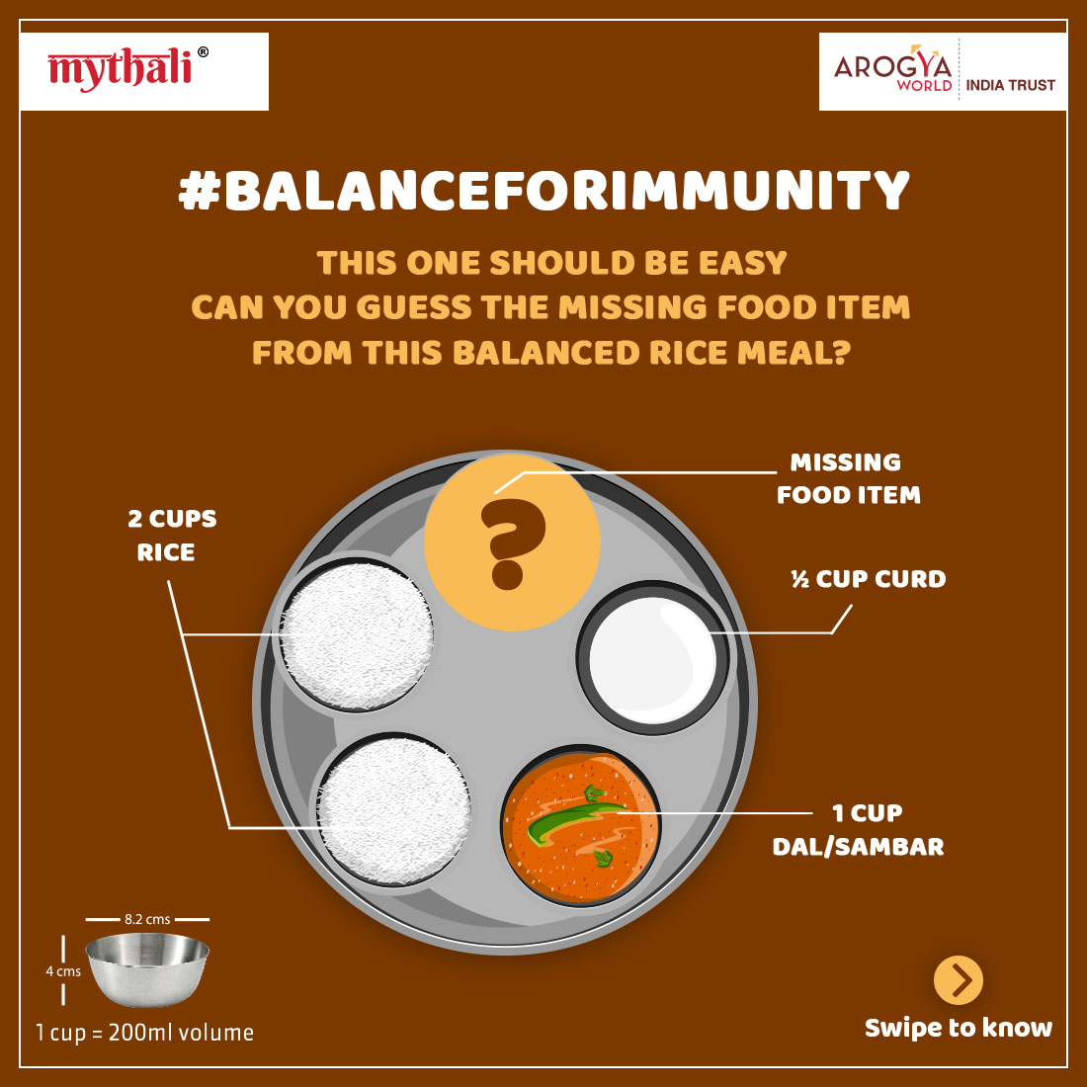
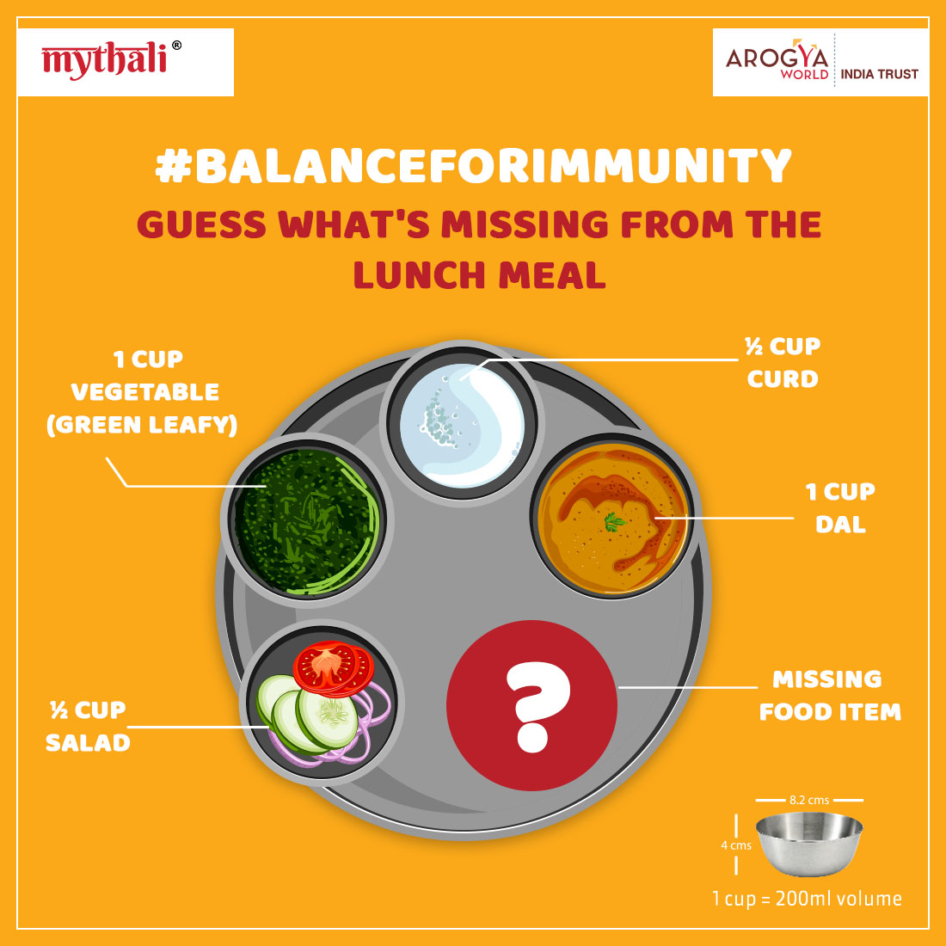
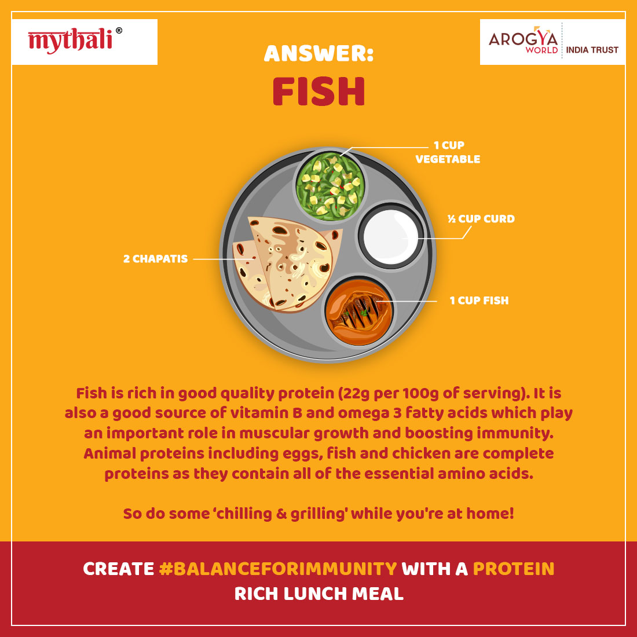
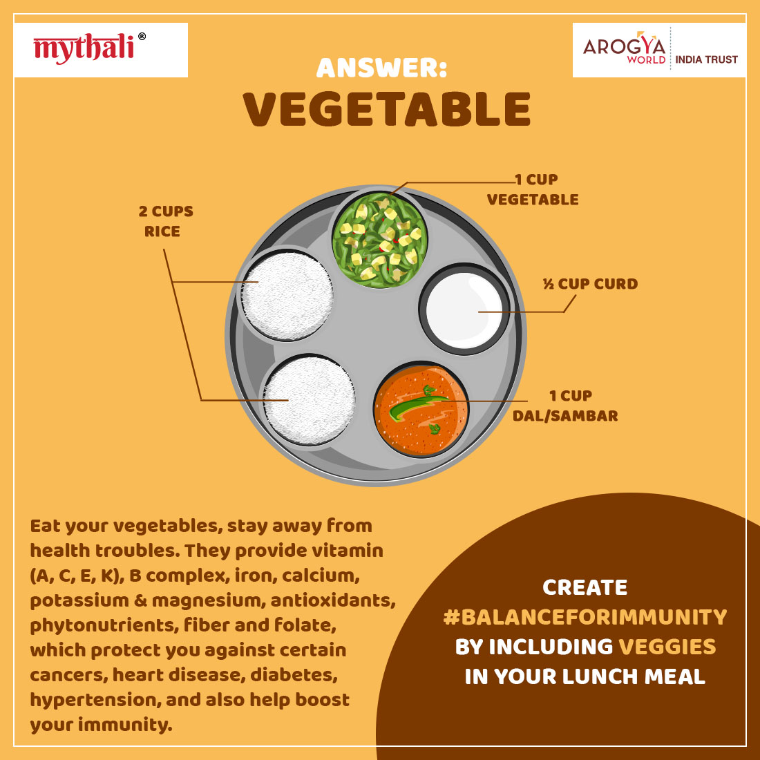
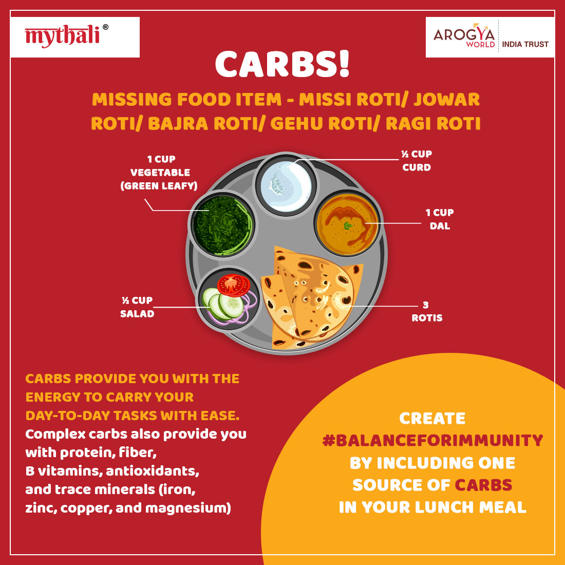
Urban MyThali: Campaign
IMMUNITY BOOSTING FOODS - DURING COVID: March – May 2020
#BALANCEFORIMMUNITY
We aimed to Increase user engagement and help consumers understand the benefit of a balanced diet and how it helps in building immunity.

Slide 9
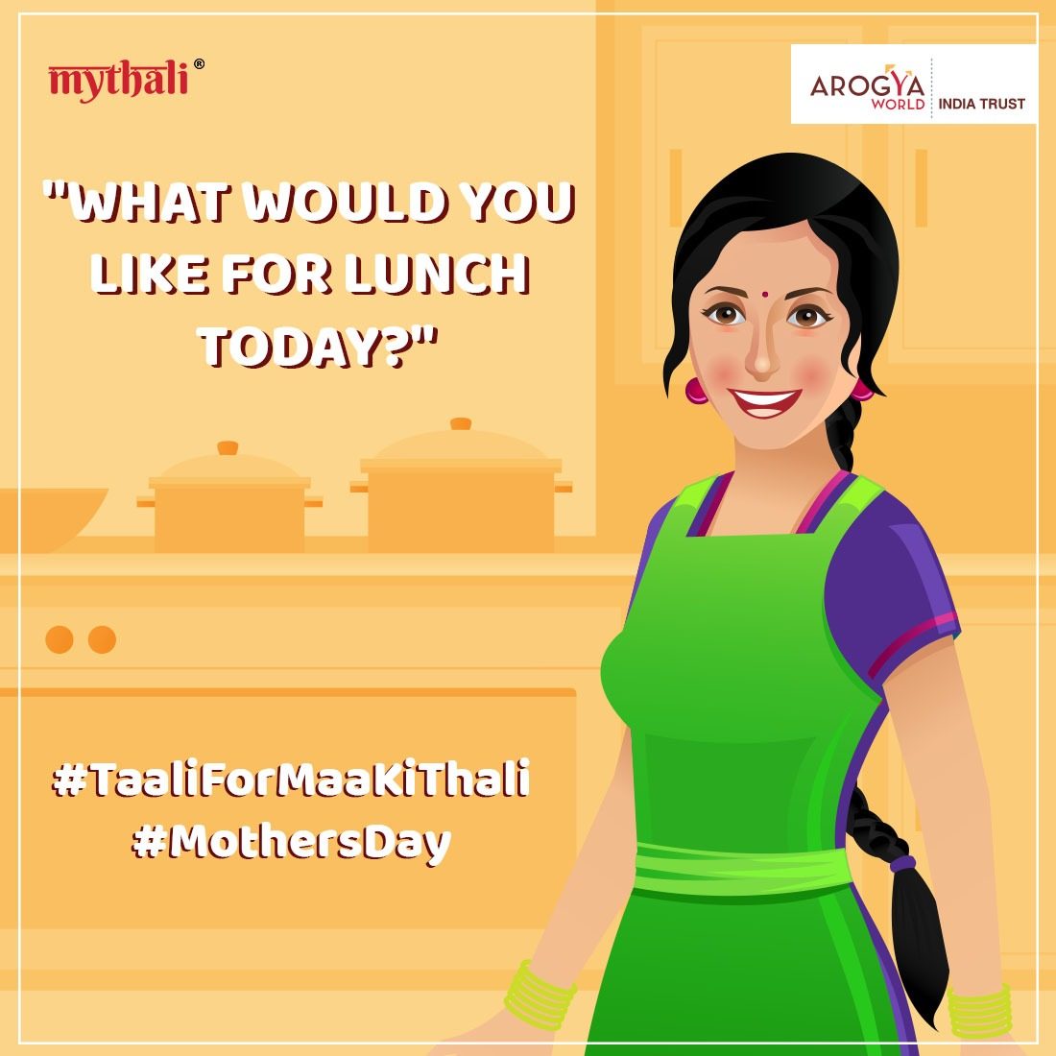
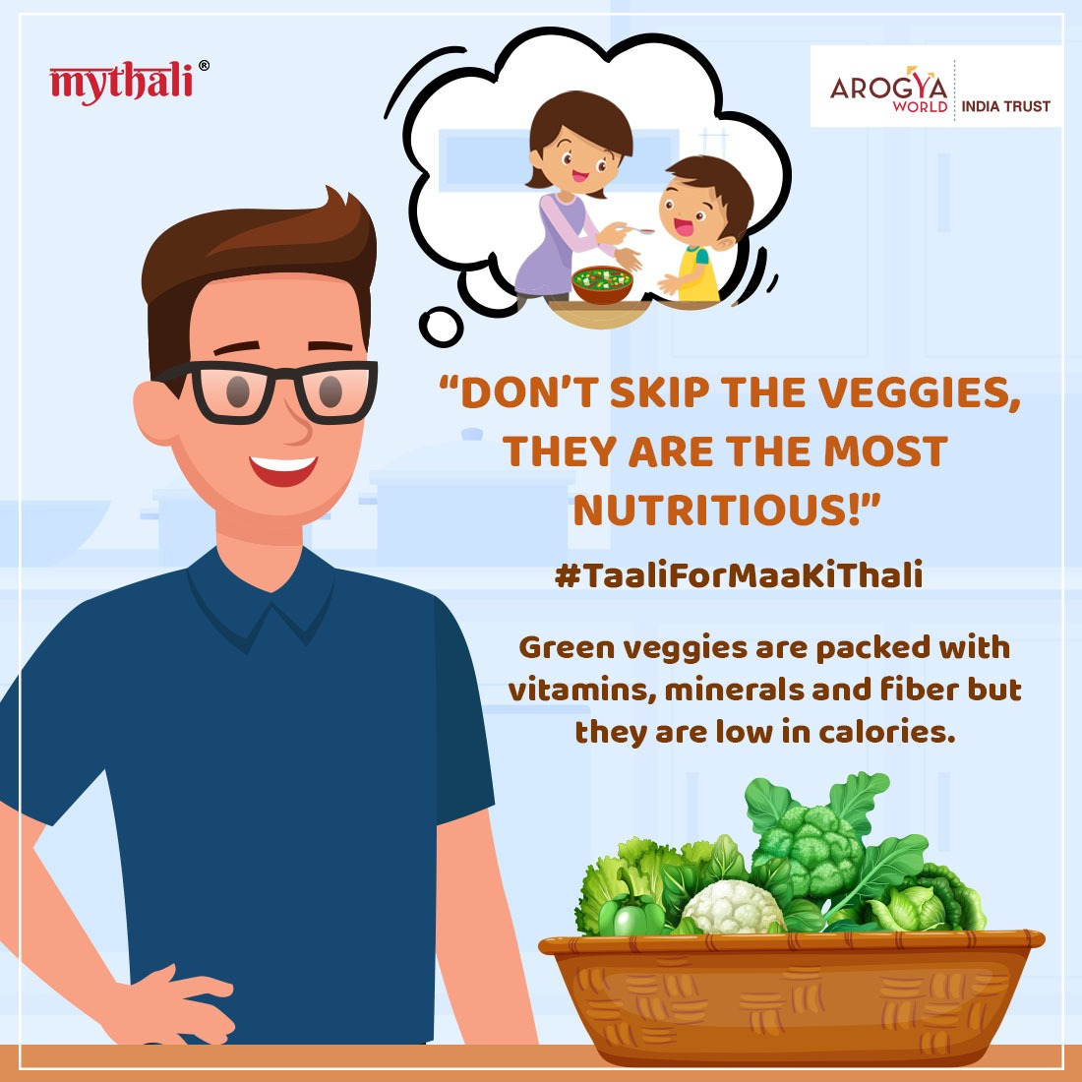
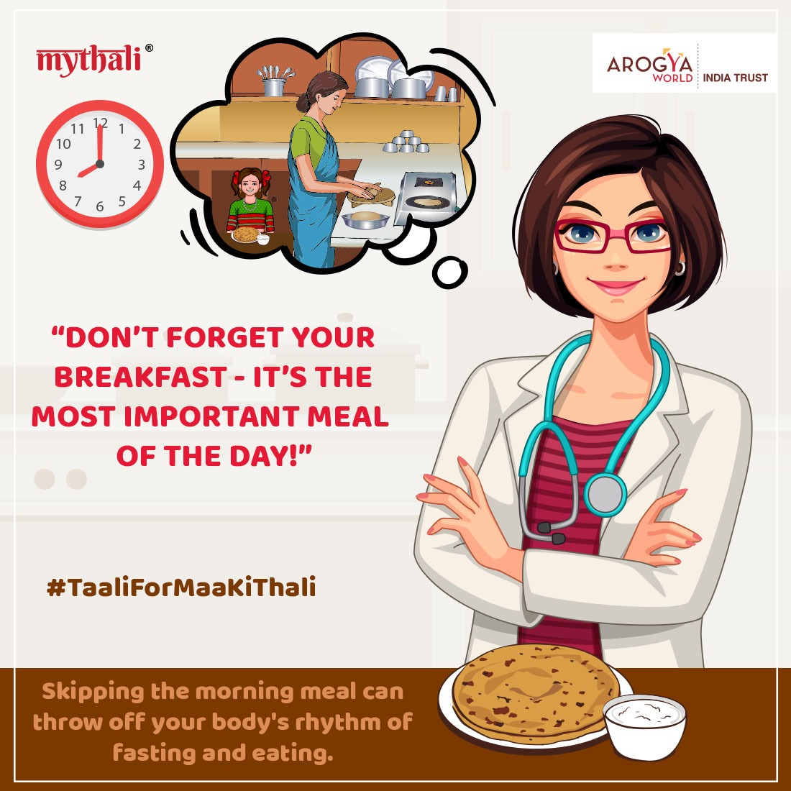
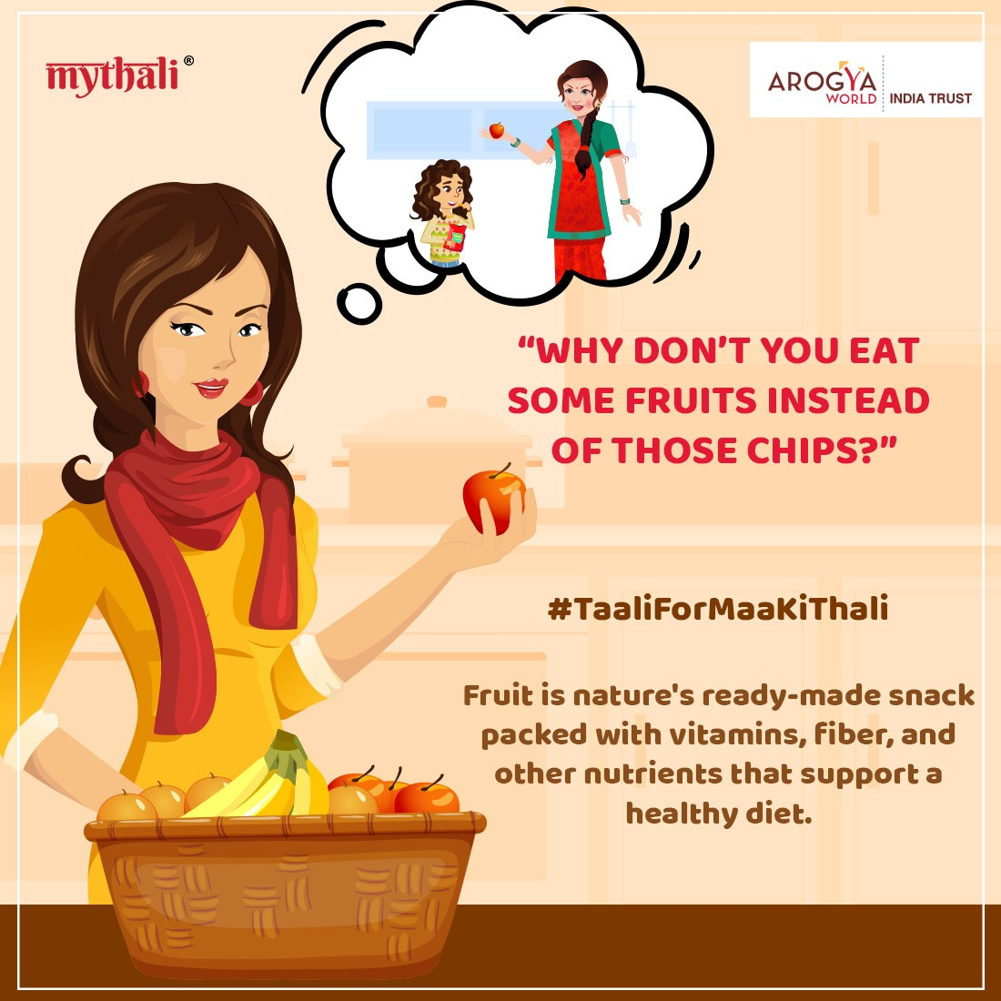
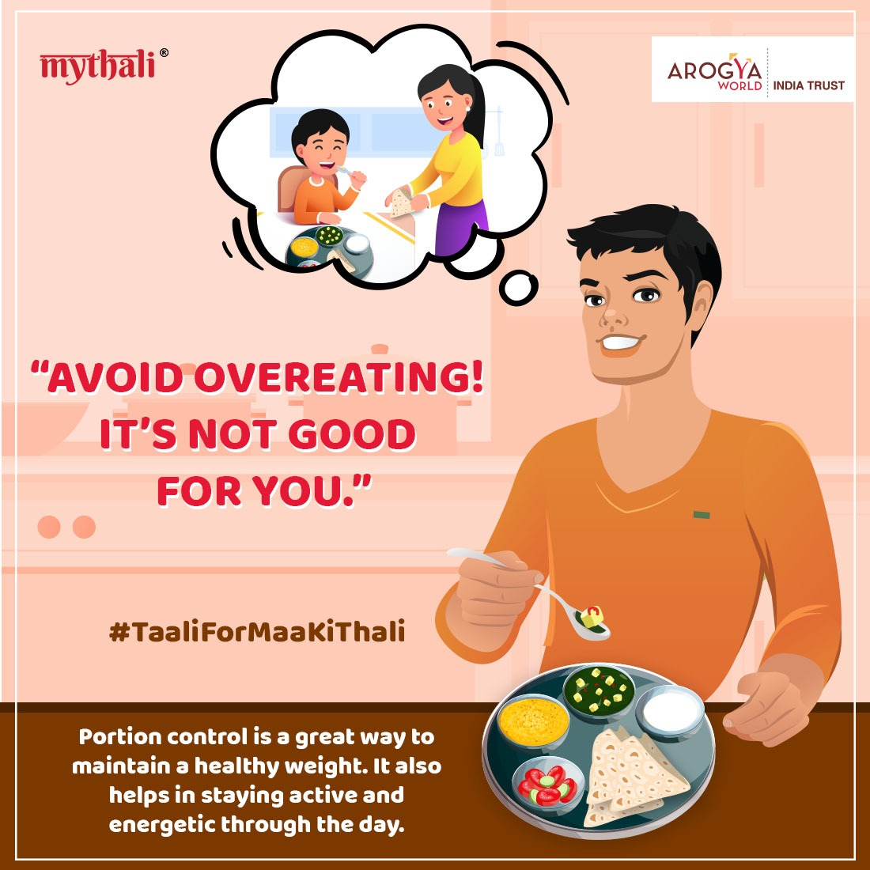
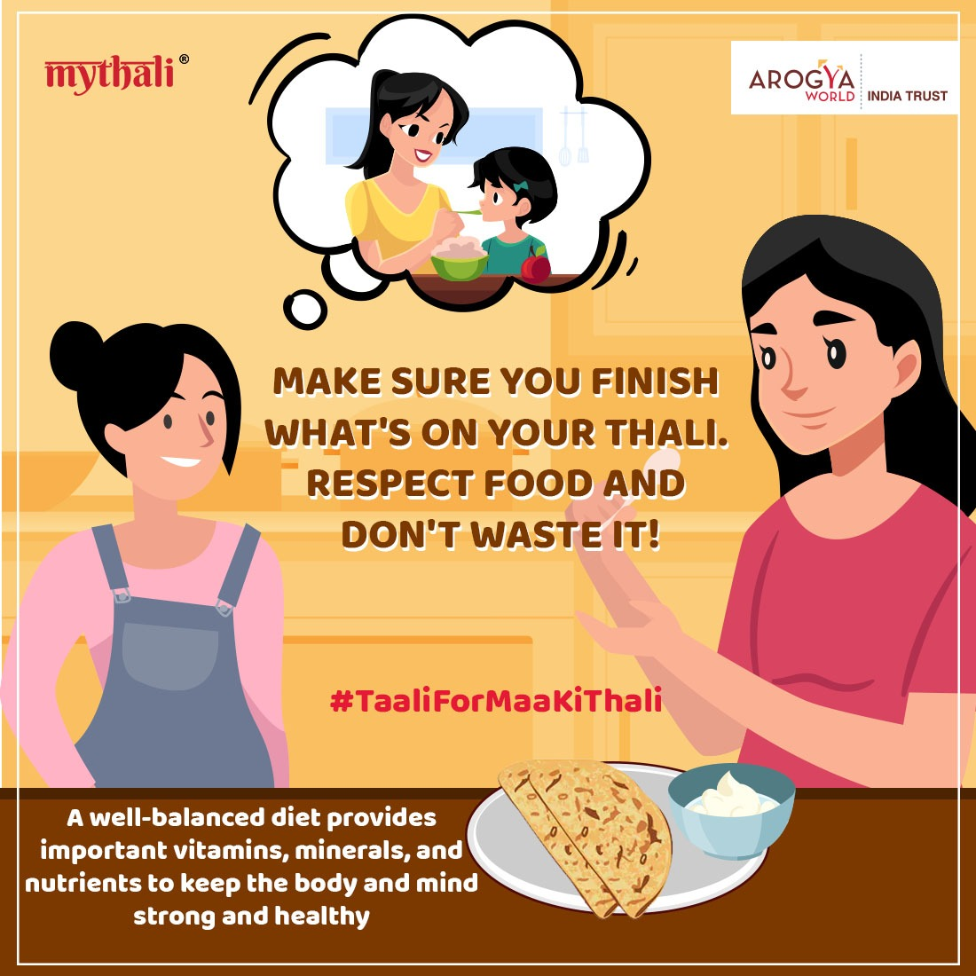

Urban MyThali: Mothers Day Campaign
May 2020
#TAALIFORMAAKITHALI
MyThali's Mother’s Day campaign asks followers to appreciate their mother’s cooking.
Through this campaign, we want children to take their turn at looking after their mothers, motivating them through social media posts on various topics on nutrition. As a prompt, we asked our followers to show us their favorite Maa ki Thali (meal prepared by their mother). At the end of the campaign, three followers will have a chance to give their mother's a free nutritional session with our nutitionist.

Slide 10

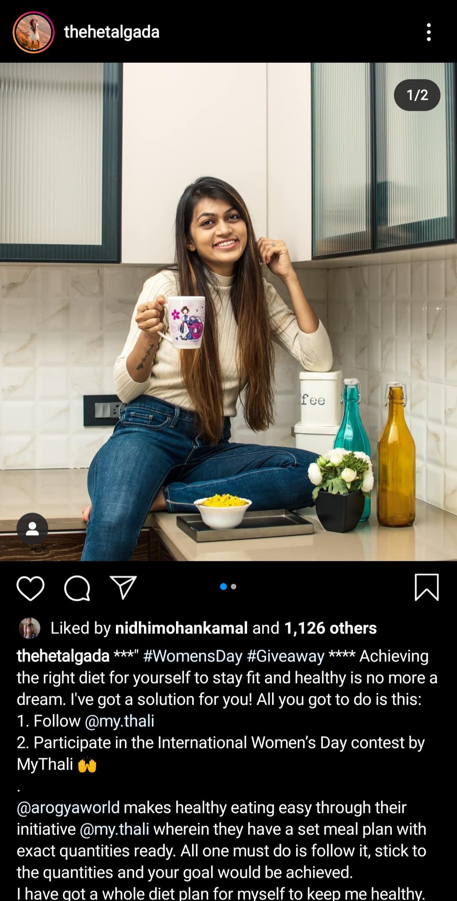
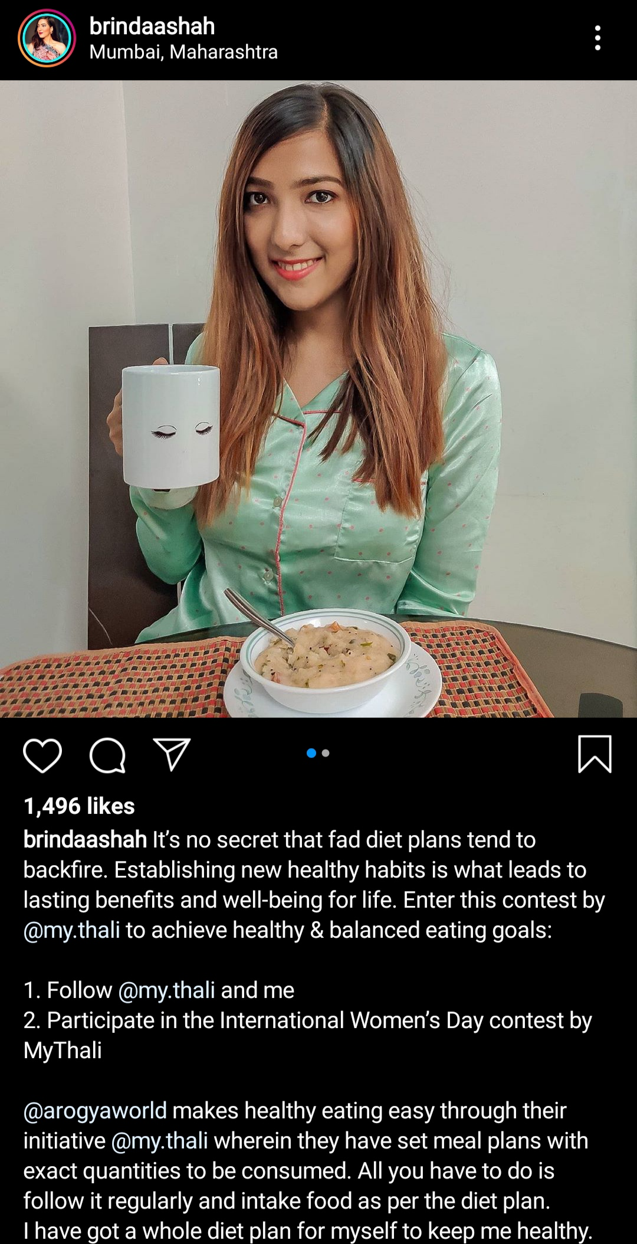
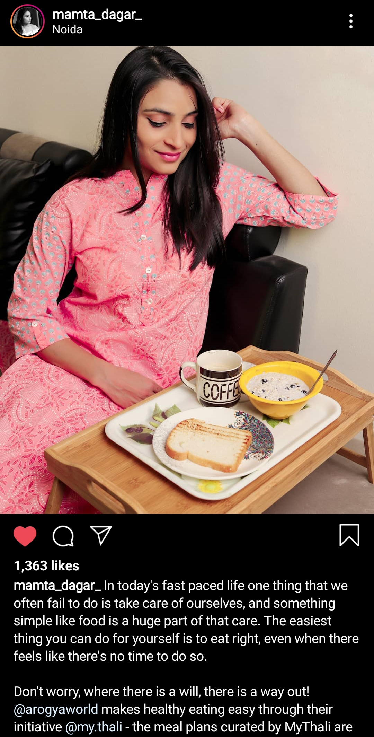
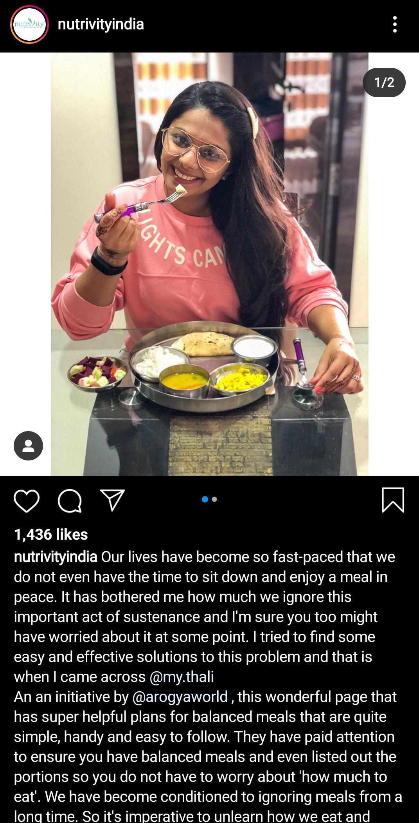
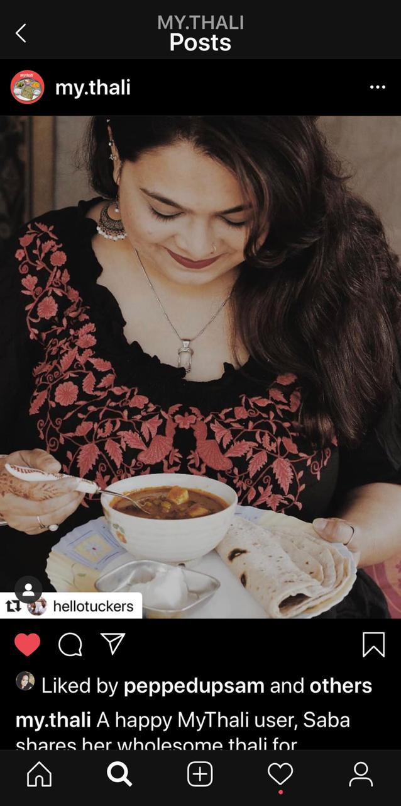
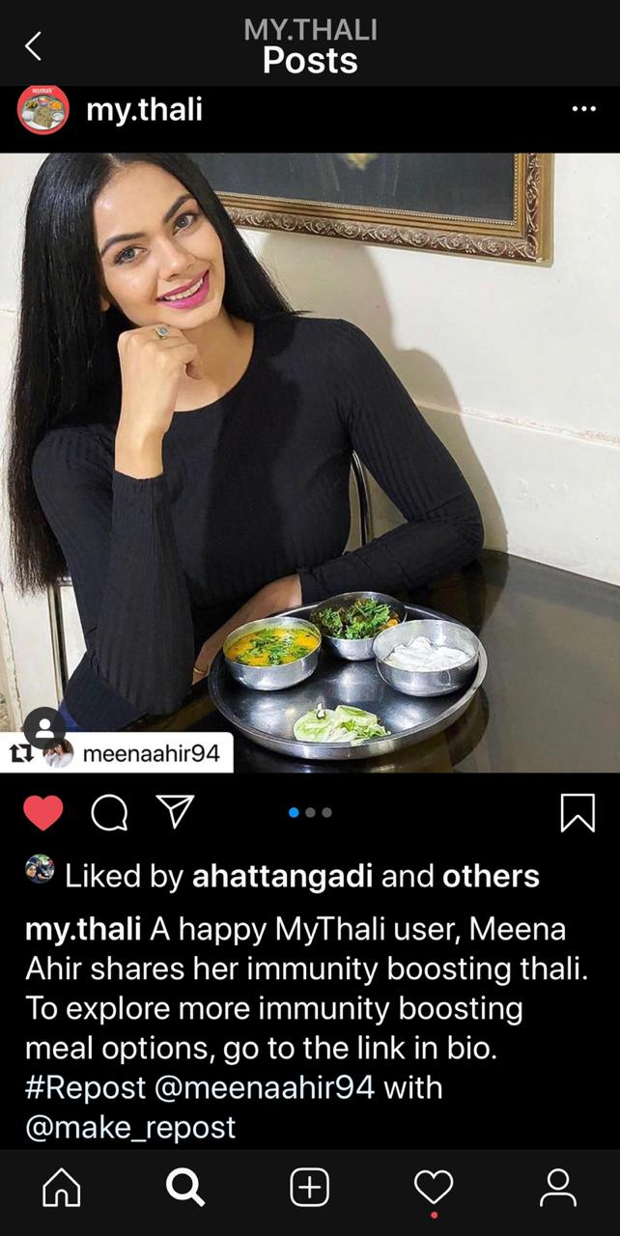
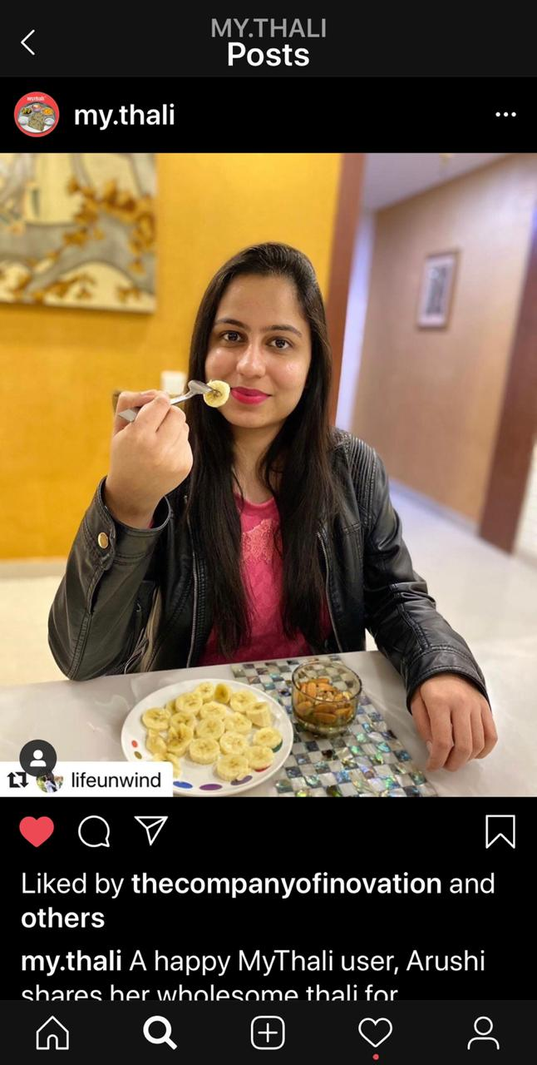
Urban MyThali
INFLUENCER OUTREACH THROUGH SOCIAL MEDIA
In order to reach to MyThali’s target audience, we engaged with micro-influencers with followers who are urban women looking for nutrition advice from credible sources. These included health & nutrition, lifestyle, food & travel influencers. The idea was to tap into the follower base of these influencers
A list of 18 micro-influencers were identified for this purpose. 7 Influencers were engaged till April 2020 and additional 4 influencers have been identified for next few months.

Slide 11
Urban MyThali
OUTREACH THROUGH TRADITIONAL MEDIA : Articles in Online Publications
List of Articles Published Online:
OnlyMyHealth
https://www.onlymyhealth.com/here-are-a-few-healthy-eating-tips-by-dr-meghana-pasi-1581047027
https://www.onlymyhealth.com/international-womens-day-empower-urban-sedentary-indian-women-towards-healthy-and-energetic-living-1583549059
Times of India
https://timesofindia.indiatimes.com/life-style/food-news/a-balanced-meal-plan-to-help-survive-the-lockdown/photostory/75161590.cms
Indian Express
https://indianexpress.com/article/lifestyle/health/woman-sedentary-lifestyle-easy-healthy-diet-tips-exercises-lose-weight-6365410/
https://indianexpress.com/article/lifestyle/health/mothers-day-2020-eating-right-diet-tips-healthy-simple-meal-plans-calcium-immunity-6397956/
The Quint
https://fit.thequint.com/coronavirus/how-to-build-immunity-during-home-quarantine-coronavirus
Your Story
https://yourstory.com/weekender/boost-immunity-home-cooked-meals-meghana-pasi
Financial Express
https://www.financialexpress.com/lifestyle/happy-mothers-day-2020-is-your-mother-eating-right-time-to-prioritize-mothers-nutrition-and-health/1953812/

Slide 12
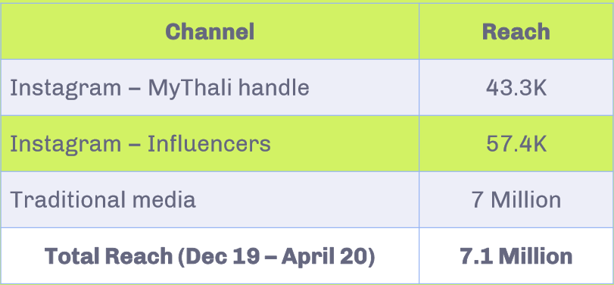
Urban MyThali TOTAL REACH

Slide 13

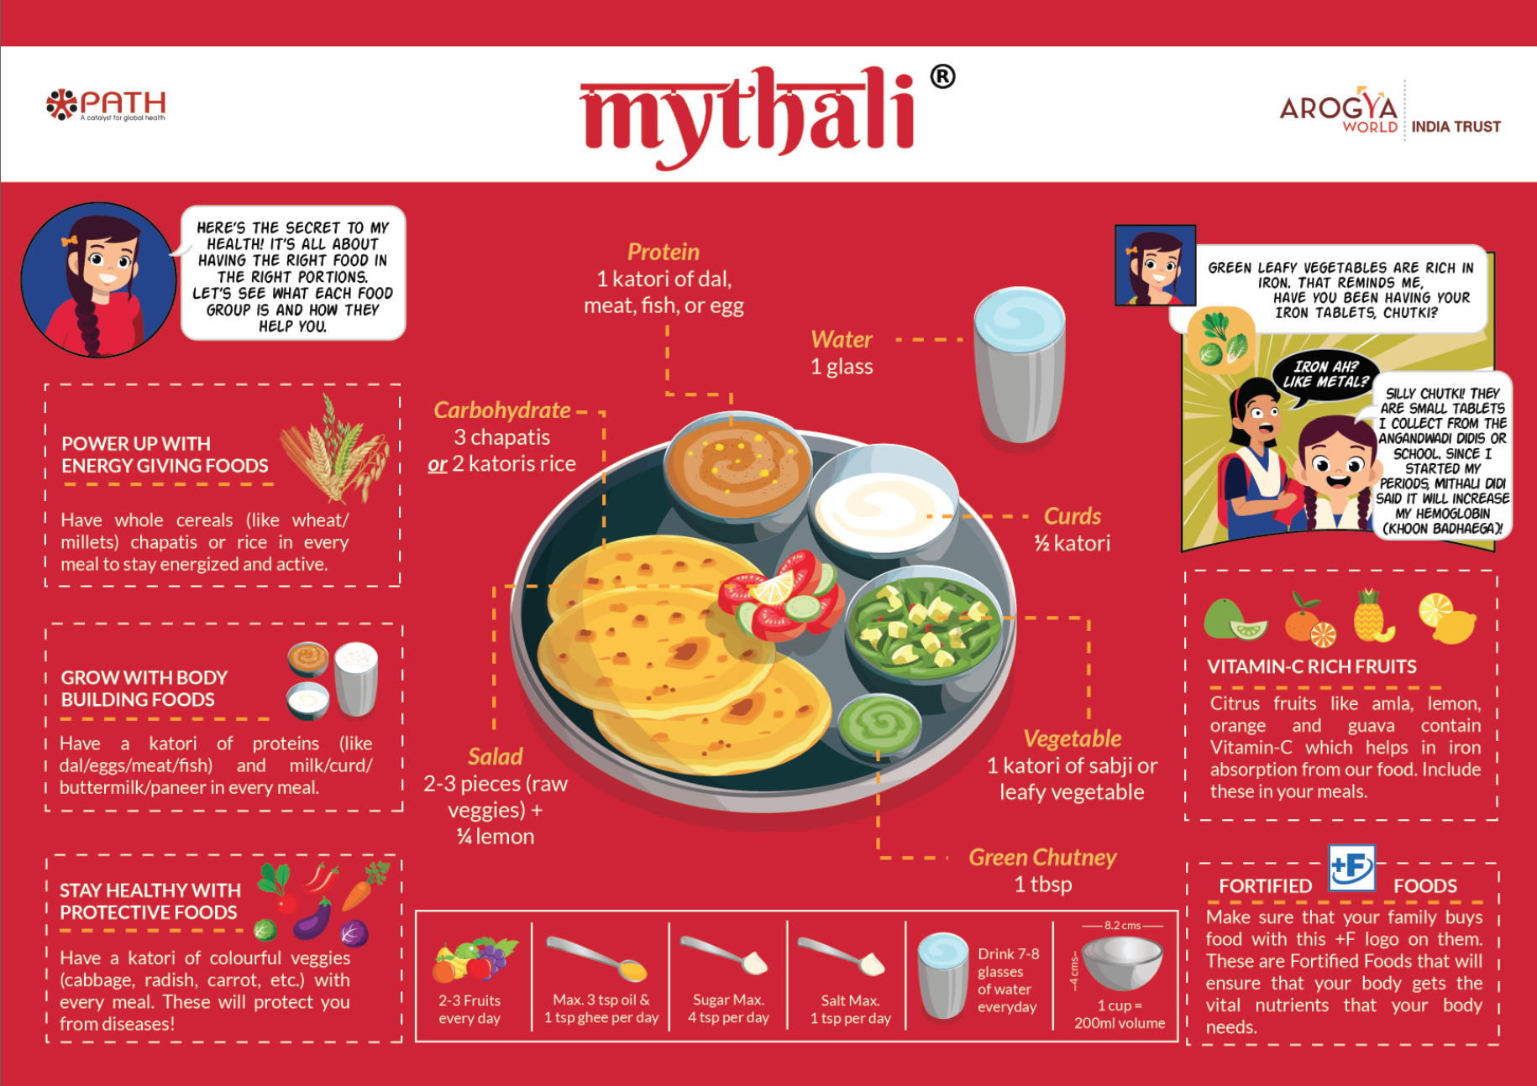
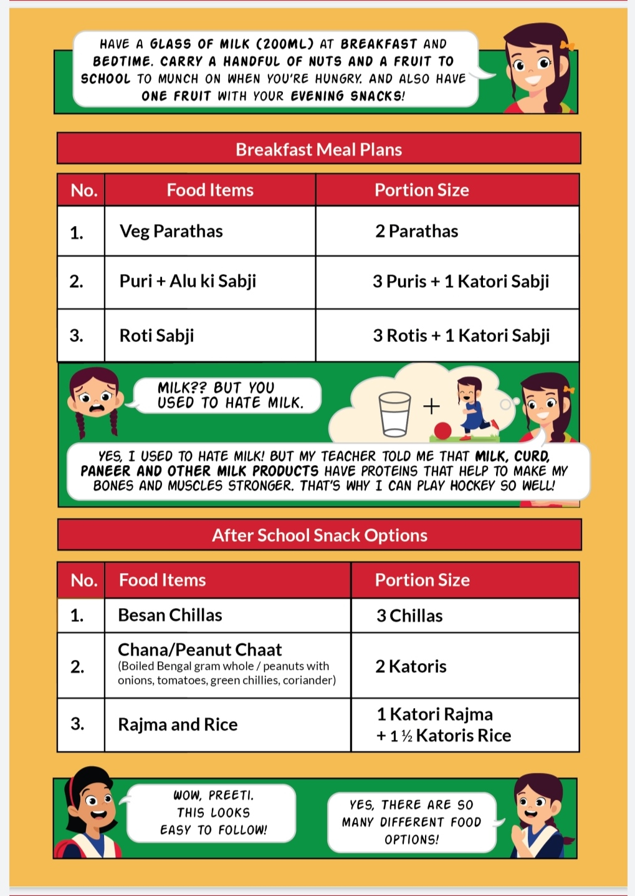
Rural MyThali: Booklet March-May 2020
The rural MyThali program focuses on empowering and educating rural middle school girls and those from urban slums on the importance of nutrition and eating right. For this, we have developed an 8 page comic-book and activity booklet that is increasingly being recognized as social and behavior change tool.

